Slide 1
Hacker Techniques, Tools, and Incident Handling
Chapter 15
Defensive Technologies

Slide 2
Learning Objective
Identify security controls and defensive technologies.

Slide 3
Key Concepts
Intrusion detection/prevention systems
Firewalls and other detection methods
Common security issues

Slide 4
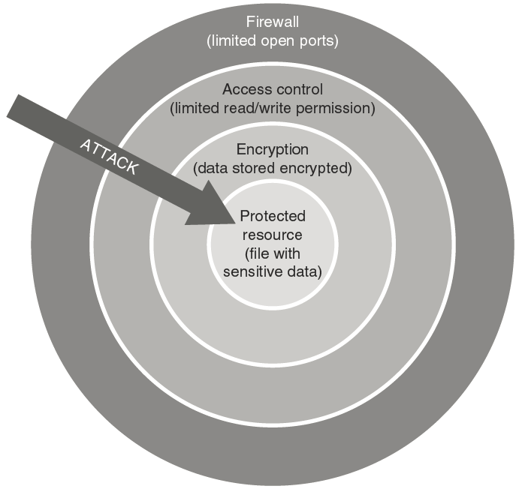
Defense in Depth
Notes:
Minimize attack surface of any protected resource.
Remove or reduce the ability of an attacker to conduct an attack against vulnerability.
Use a combination of strategies to provide higher level of security.
Never rely on a single control to protect a resource.
Design a multilayered defense strategy.
Security strategy is often called defense in depth.

Slide 5
Intrusion Detection Systems: Key Terms
Intrusion
Intrusion detection
Misuse detection
Misuse
Notes:
Intrusion — An unauthorized use or access of a system by an individual, party, or service
Misuse — The improper use of privileges or resources within an organization; not necessarily malicious in nature, but misuse all the same
Intrusion detection — The technique of uncovering successful or attempted unauthorized access to an information system
Misuse detection — The ability to detect misuse of resources or privileges

Slide 6
IDS Mechanisms
Anomaly detection
Signature recognition
Notes:
Signature recognition — Commonly known as misuse detection, it attempts to detect activities that may be indicative of misuse or intrusions.
Signature analysis refers to an IDS that is programmed to identify known attacks occurring in an information system or network.
Most IDSs are based on signature analysis.
Anomaly detection — A type of detection that uses a known model of activity in an environment and reports deviations from this model as potential intrusions.
The model is generated by the system owner based on knowledge of what is acceptable and known behavior on the network.
In modern systems, the IDS will be configured to observe traffic in a training mode in which it observes and learns what is normal and what is not on a given network.

Slide 7
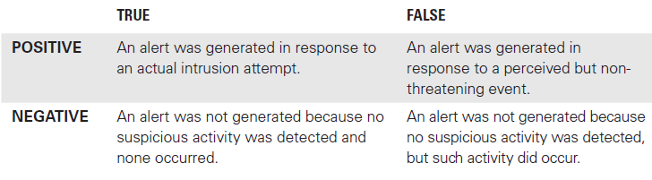
IDS Response Matrix

Slide 8
Types of IDSs
Host-based intrusion detection system (HIDS)
Network-based intrusion detection system (NIDS)
Log file monitoring
File integrity checking
Notes:
Network-based intrusion detection system (NIDS) — An IDS that fits into this category is one that can detect suspicious activity on a network
Host-based intrusion detection system (HIDS) — An IDS that can monitor activity on a specific host or computer
Log file monitoring — Software that is designed to analyze log files and look for specific events or activities
File integrity checking — Software that looks for changes in files that may indicate an attack or unauthorized behavior; one of the oldest and simplest types of IDS

Slide 9
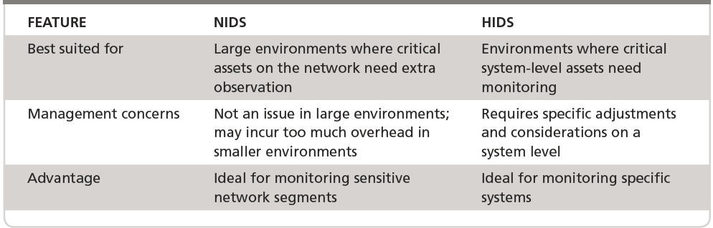
NIDS and HIDS Features

Slide 10
IDS Components
Pattern recognition and pattern matching to known attacks
Analysis of traffic for abnormal communication
Integrity checking of files
Tracking of user and system activity
Traffic monitoring
Traffic analysis
Events log monitoring and analysis

Slide 11
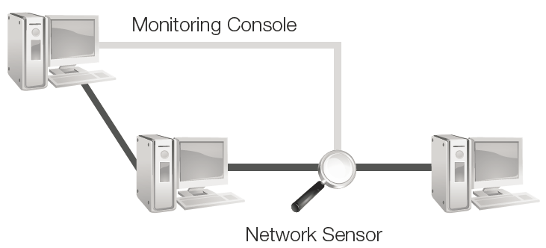
Components of a NIDS
Notes:
The command (monitoring) console represents the component where the system administrator manages and monitors the system. This is where the administrator carries out the day-to-day tasks of monitoring, tuning, and configuring the system to maintain optimal performance. The command console may be accessed from anywhere, or its access may be restricted to a specific system for security purposes.
The network sensor is a discrete software application that runs on a designated device or system as needed. This sensor is essentially the same as a sniffer in that it runs in conjunction with a network card in promiscuous mode. The sensor has the ability to monitor traffic on a specific segment of the network because of the same restrictions that are placed on sniffers.

Slide 12
Components of a NIDS (Cont.)
Steps an IDS uses for signature-based detection:
A host creates a network packet. At this point nothing is known other than the packet exists and was sent from a host in the network.
The sensor sniffs the packet off the network segment. This sensor is placed so it can read the packet.
The IDS and the sensor match the packet with known signatures of misuse. When a match is detected, an alert is generated and sent to the command console.

Slide 13
Components of a NIDS (Cont.)
Steps an IDS uses for signature-based detection:
The command console receives and displays the alert, which notifies the security administrator or system owner of the intrusion.
The system owner responds based on the information the IDS provides.
The alert is logged for future analysis and reference. This information can be logged in a local database or in a central location shared by several systems.

Slide 14
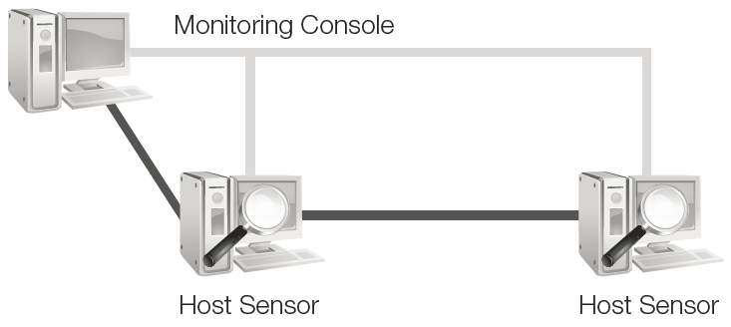
Components of a HIDS
Notes:
The command (monitoring) console acts much like its counterpart on the NIDS. This piece of software is the component that the network administrator
will spend the most time with. Here, the administrator will configure, monitor, and manage the system as needs change.
The monitoring agent software (host sensor) is responsible for monitoring the activities on a system. The agent will be deployed to the target system and monitor activities such as permission usage, changes to system settings, file modifications, and other suspicious activity on the system

Slide 15
Setting Goals
Response Capability
Response Accountability

Slide 16
Limitations of an IDS
Know strength and weaknesses of your IDS technology
IDS supplements existing security technologies
IDS only detects and reports what you tell it to
Understand and update your network
If hardware supporting the IDS fails, the IDS may become ineffective or worthless
IDS provides a way to detect an attack but not how to deal with it — this belongs to the organization’s intrusion prevention system (IPS)
IDS may generate extensive data which must be analyzed to ensure attacks are caused

Slide 17
Intrusion Prevention Systems
IPS responses to an attack
Regulating and stopping suspicious traffic
Blocking access to systems
Locking out misused user accounts
Notes:
An intrusion prevention system (IPS) is the next step beyond an IDS. The IPS is a device that is used to protect systems from attack by using different methods of access control.

Slide 18
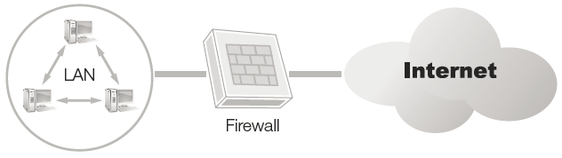
Purpose of Firewalls
Control the flow of network traffic
Separate networks and organizations into different zones of trust
On perimeter, form a logical and physical barrier between the organization’s network and everything outside
Segment a network internally or within the organization

Slide 19
Firewall Modes
Packet filtering
Stateful inspection
Application proxying
Notes:
Packet filtering represents the first generation of firewalls. Firewalls that used packet filtering only could only do the most basic analysis of traffic.
Firewalls may use stateful packet inspection (SPI) where the attributes of each connection are noted and stored by the firewall.
Application proxy performs translation of the address and additional access control checking and logging and then connects to the server on behalf of the client.

Slide 20
Limitations of a Firewall
Viruses
Misuse
Secondary connections
Social engineering
Poor design
Notes:
Viruses — Although some firewalls do include the ability to scan for and block viruses, this is not defined as an inherent ability of a firewall and should not be relied upon.
Misuse — Employees already have a higher level of access to the system. Employees sometimes disregard company rules against bringing in software from home or downloading from the Internet. Firewalls cannot perform well against intent.
Secondary connections — In some situations, secondary access occurs and presents a major problem. For example, if a firewall is put in place but employees can connect to mobile hotspots on their smartphones, thus bypassing the corporate network, the employees have now opened a hole in the firewall.
Social engineering — Suppose a network administrator gets a call from someone who says he works for the Internet service provider that serves the administrator’s network. The caller wants to know about the company’s firewalls. If the administrator gives out the information without checking the caller’s identity and confirming that he needs to know what he’s asking about, the firewalls can lose their effectiveness.
Poor design — A firewall design that has not been well thought out or implemented can have security holes or gaps. Always ensure that proper security policy and practices are followed.

Slide 21
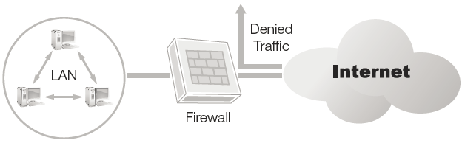
Implementing Firewalls: Single Packet-Filtering Device
Network is protected by a single packet-filtering device configured to permit or deny access

Slide 22
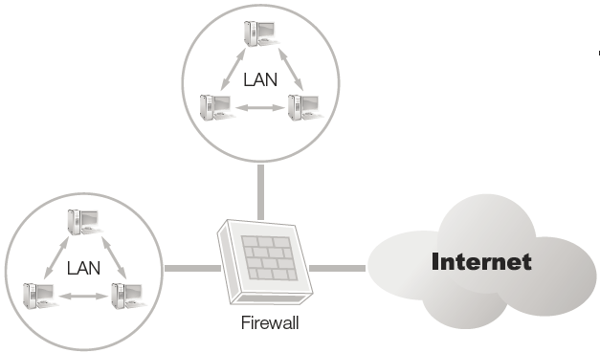
Implementing Firewalls: Multi-homed Device
Device has multiple network interfaces that use rules to determine how packets will be forwarded between interfaces

Slide 23
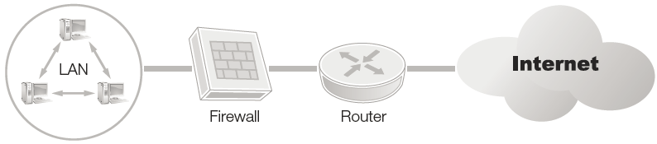
Implementing Firewalls: Screened Host
Network is protected by a device that combines the features of proxy servers with packet filtering

Slide 24
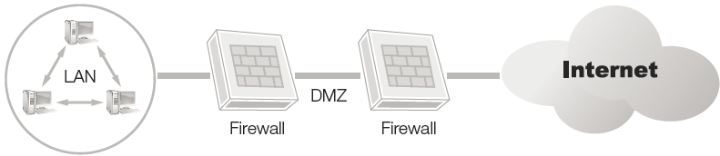
Implementing Firewalls: Demilitarized Zone (DMZ)
Region of network or zone that is sandwiched between two firewalls
Set up to host publicly available services

Slide 25
Firewall Policy
The blueprint that dictates how the firewall is installed, configured, and managed
Represents a subset of the overall organizational security policy
Two common approaches:
Implicitly allow everything, explicitly deny only those things you do not want
Implicitly deny everything, allow only those things you know you need

Slide 26
Network Connectivity Policy
Network scanning prohibited except by approved personnel
Only certain types of network communication allowed
Users may access the web via port 80, as required
User may access email on port 25, as required
Users may not access Network News Transfer Protocol (NNTP)
Antivirus software and updates must be installed and running and computers and servers
Only network administrators may install new hardware on any computer
Don’t allow unauthorized connections to the Internet

Slide 27
Contracted Worker Statement
No access to unauthorized resources
Not permitted to scan the network
May not use FTP unless granted permission in writing

Slide 28
Firewall Administrator Statement
Be trained on firewall in use
Be aware of all authorized applications and services
Reports to an entity such as chief information officer
Must have procedure to reach firewall administrator in even of a security incident

Slide 29
Honeynets and Honeypots
Honeypot: A computer configured to attract attackers to it; acts as a decoy
Placed in a location so that if an attacker is able to get around the firewall and other security devices, honeypot draws attention away from more sensitive assets
Honeynet: A group of vulnerable systems (honeypots) or a network

Slide 30
Legal Issues
Legal
Entrapment
Notes:
If you put a honeypot out there where someone can attack it, and they do, can you prosecute the attacker for a crime?
Would the honeypot be admissible as evidence?
Are honeypots entrapment?

Slide 31
Role of Controls
Administrative, technical, and physical controls are part of a layered approach
By combining layers, you gain:
Advantage of multiple mechanisms to protect systems
Advantage of having a hedge against failure; if one layer or mechanism fails, you have others to fall back on

Slide 32
Common Controls
Administrative
Implicit deny, least privilege, separation of duties, job rotation, required vacation, privilege management
Technical
Access control software, malware solutions, passwords, security tokens, biometrics, antivirus software
Physical
Alternative power sources, flood management, fences, guards, locks, fire suppression system, biometrics, building design and location

Slide 33
Security Information and Event Management (SIEM)
Collection of software and devices that help security professionals manage their environments
Monitors log files, network traffic, and processes for security events
Provides real-time analysis, stores activity for trend analysis, and triggers alerts for suspect activity
Provides tools to manage security controls and the collection of security event data

Slide 34
Sources for Guidance
A Security Technical Implementation Guide (STIG):
National Institute of Standards and Technology (NIST) National Checklist Program Repository (https://nvd.nist.gov/ncp/repository)
Information Assurance Support Environment (IASE) STIGs (https://iase.disa.mil/stigs/Pages/index.aspx)
STIG search tool (https://stigviewer.com/)

Slide 35
Summary
Intrusion detection/prevention systems
Firewalls and other detection methods
Common security issues

